Slide 1
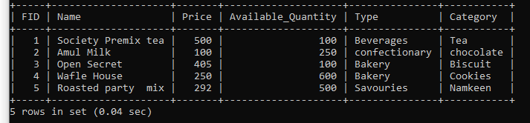
Food Ordering System
CREATE TABLE Food ( FID int NOT NULL PRIMARY KEY AUTO_INCREMENT, Name varchar(255) NOT NULL,
Price double,
Available_Quantity int,
Type varchar(255) NOT NULL,
Category varchar(255) NOT NULL );
FUNCTIONALITY
INSERT DATA
INSERT into Food( Fid,Name,Price,Available_Quantity,Type,Category) VALUES
(1,”Society Premix tea”,500,100,”Beverages”,”Tea”),(2,”Amul Milk”,100,250,”confectionary”,”chocolate”),(3,”Open Secret”,405,100,”Bakery”,”Biscuit”),
(4,”Wafle House”,250,600,”Bakery”,”Cookies”),(5,”Roasted party mix”,292,500,”Savouries”,”Namkeen”);
Select * from Food;

Slide 2
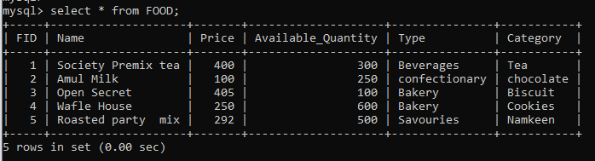
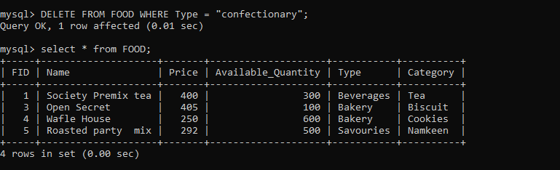
FUNCTIONALITY
UPDATE DATA
DELETE DATA

Slide 3
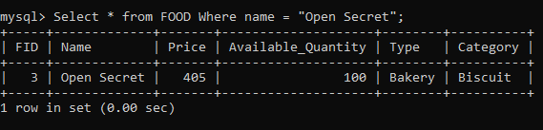
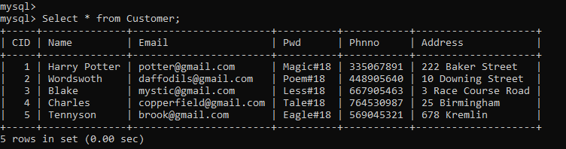
Retrieve Data on basis of Food Name
Select * from FOOD Where name = “Open Secret”;
Retrive data on basis of food type
Select * from FOOD Where Type = “Bakery”;

Slide 4
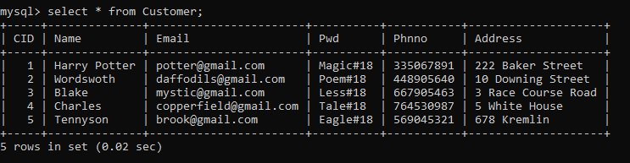
Customer Table
CREATE TABLE Customer
( CID int NOT NULL PRIMARY KEY AUTO_INCREMENT,
Name varchar(30) NOT NULL,
Email varchar(30) NOT NULL,
Pwd varchar(30) NOT NULL,
Phnno int(11) NOT NULL,
Address TEXT(30) NOT NULL
);
FUNCTIONALITY
INSERT DATA
INSERT INTO CUSTOMER(CID, Name,Email,Pwd,Phnno,Address) VALUES
(1,”Harry Potter”,”potter@gmail.com”, “Magic#18”, 335067891,”222 Baker Street”),
(2,”Wordswoth”,”daffodils@gmail.com”,”Poem#18”, 448905640,”10 Downing Street”),
(3,”Blake”,”mystic@gmail.com”,”Less#18”,667905463,”3 Race Course Road”),
(4,”Charles”,”copperfield@gmail.com”,”Tale#18”,764530987,”5 White House”),
(5,”Tennyson”,”brook@gmail.com”,”Eagle#18”,569045321,”678 Kremlin”);

Slide 5
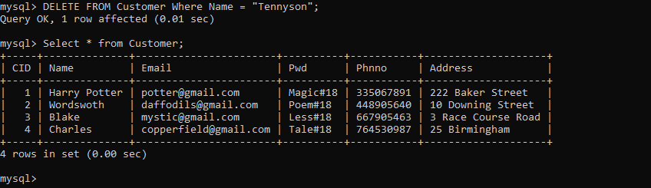
FUNCTIONALITY
UPDATE DATA
UPDATE Customer
SET Address = “25 Birmingham” Where Name = “Charles”;
Select * from Customer;
DELETE DATA
DELETE FROM Customer Where Name = “Tennyson”
Select * from Customer;

Slide 6
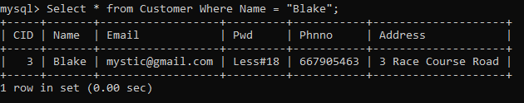
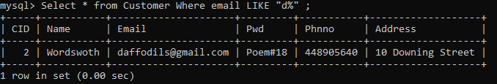
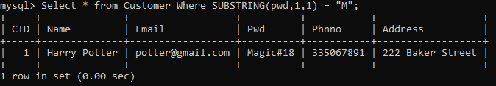
Retrieve Data on basis of Customer Name Select * from Customer Where Name = “Blake”;
Retrieve Data based on email
Select * from Customer Where email LIKE “d%”;
Retrieve Data on basis of 1st letter
Select * from Customer Where SUBSTRING(pwd,1,1) = “M”;

Slide 7
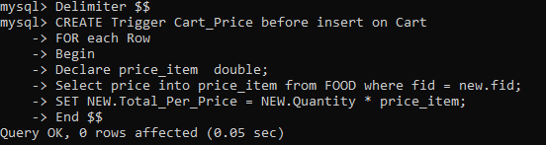
Cart Table
CREATE TABLE Cart ( ID int NOT NULL PRIMARY KEY,
CID int NOT NULL,
FOREIGN KEY (CID) REFERENCES CUSTOMER(CID),
FID int NOT NULL,
FOREIGN KEY (FID) REFERENCES Food(FID), Quantity int DEFAULT 1,
Total_per_price DECIMAL(10,2) DEFAULT 0.0);
Create a trigger on cart before insert or before update to calculate per price
example: food price: 100 qnt: 2 totalperPrice=price*qnt=> 100*2+>200

Slide 8
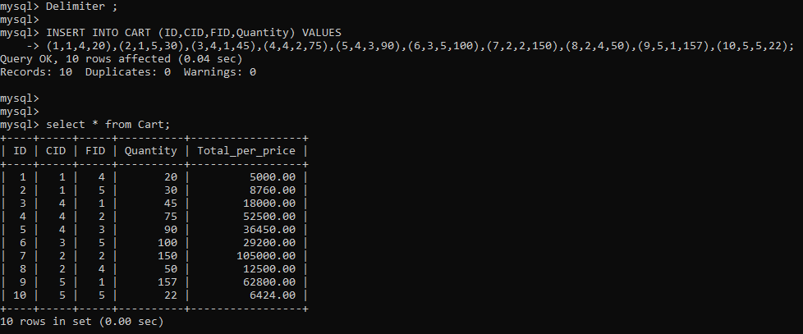
INSERT DATA WITH TRIGGER ACTION
INSERT INTO CART (ID,CID,FID,Quantity) VALUES
(1,1,4,20),(2,1,5,30),(3,4,1,45),(4,4,2,75),(5,4,3,90),(6,3,5,100),(7,2,2,150),(8,2,4,50),(9,5,1,157),
(10,5,5,22);

Slide 9
Update Quantity on basis of Cust ID
TRIGGER BEFORE UPDATE
Delimiter $$
CREATE Trigger Cart_Price_update before update on Cart
FOR each Row
Begin
Declare price_item double;
Declare quantity_item int;
IF old.fid <> new.fid then
Select price into price_item from FOOD where fid = new.fid;
Else
Select price into price_item from food where fid = old.fid;
END IF;
SET quantity_item = old.quantity;
IF old.quantity <> new.quantity then
SET quantity_item = new.quantity;
END IF;
SET NEW.Total_Per_Price = quantity_item * price_item;
End $$
Delimiter ;

Slide 10
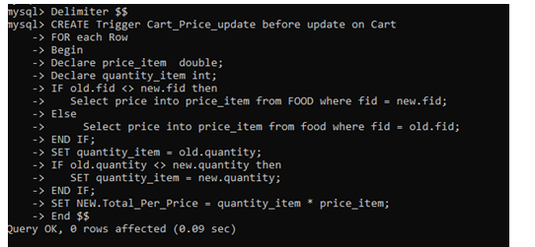
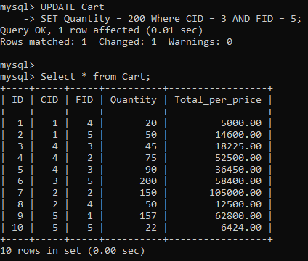
Update Quantity based on Customer ID
UPDATE Cart
SET Quantity = 200 Where CID = 3 AND FID = 5;
Select * from Cart;

Slide 11
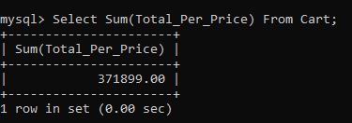
Find Sum of Total_Per_Price of Cart Table
Select Sum(Total_Per_Price) From Cart;
CREATE TABLE Orders ( OID int NOT NULL PRIMARY KEY,
CID int NOT NULL,
FOREIGN KEY (CID) REFERENCES CUSTOMER(CID),
FID int NOT NULL,
FOREIGN KEY (FID) REFERENCES Food(FID), Delivery_status tinyint(1),
Total_bill DECIMAL(10,2) DEFAULT 0.0
);

Slide 12
Inserting Data into Orders table
Trigger to calculate total bill on insert
Here the total is sum of quantity into price per customer
Delimiter $$
CREATE Trigger Order_total_bill before insert on Orders
FOR each Row
Begin
Declare total_bill_amt decimal(10,2);
Select sum(total_per_price) into total_bill_amt from cart where cid = new.cid;
SET NEW.Total_Bill = total_bill_amt;
End $$
Delimiter ;

Slide 13
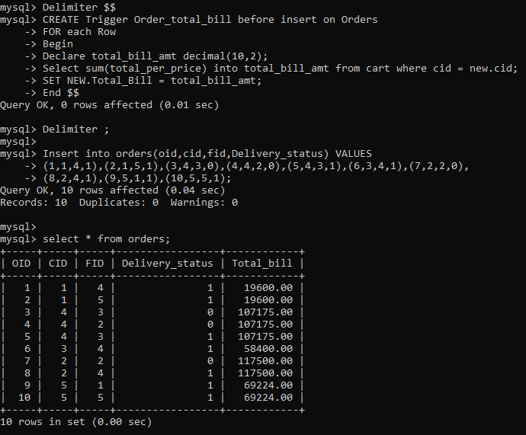
Inserting Data into Orders Table

Slide 14
Create trigger to delete data before inserting product in orders table on basis of cid
Deleting data within the trigger of BEFORE INSERT causes error Error 1442 (HY000) cant’ update
“orders” in stored function/trigger because it is already used by statement which invoked this
stored procedure.
Hence the stored procedure is created to delete data , update cart to calculate total_per_price
and insert values
Delimiter $$
CREATE PROCEDURE Delete_data_food(IN OID1 INT,IN CID1 int,IN FID1 int, IN delivery_status1
tinyint(1))
BEGIN
Delete from Orders where OID = OID1;
Update cart
SET FID = fid1 WHERE ID = oid1;
Insert into orders (oid,cid,fid,Delivery_status) VALUES (oid1,cid1,fid1,delivery_status1);
END $$
DELIMITER ;
CALL DELETE_DATA_FOOD(6,3,5,1);

Slide 15
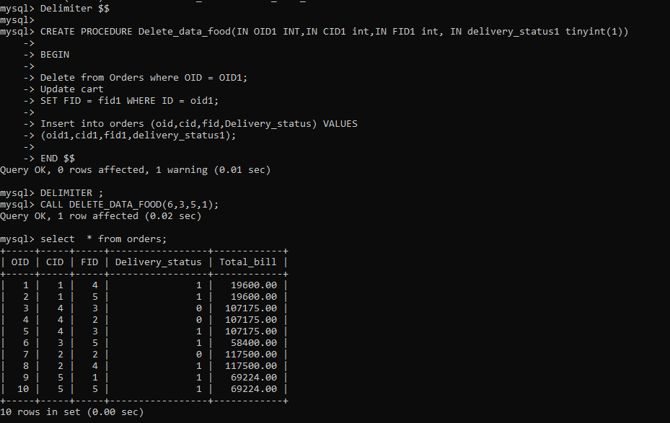
Create trigger to delete data before inserting product in orders table on basis of cid

Slide 16
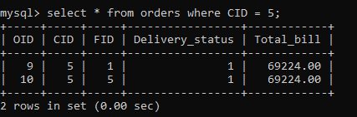
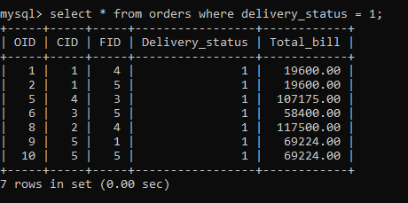
Retrieve Data on basis of CID
Retrieve Data on basis of delivery status, Since Date is not a field in orders table

Slide 17
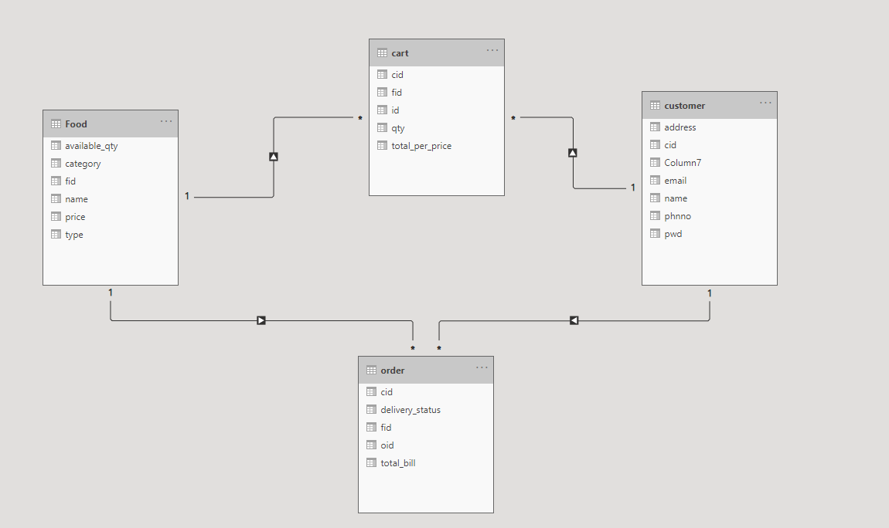
Entity Relationship Diagram

